Slide 1



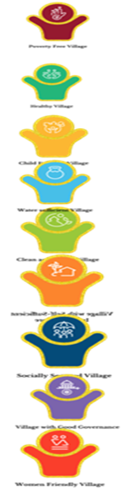
People’s Plan Campaign - 2022 (PPC-2022) for preparation of thematic GPDP for 2023-24

Slide 2

Localization of Sustainable Development Goals(LSDGs)
  India is a signatory to UN Sustainable Development Goals (SDGs) 2030 agenda consisting of 17 Goals
Achievement of 2030 International Agenda of Sustainable Development Goals through grossroot level interventions
  Around 68% of population resides in rural areas mainly falls under the purview of Panchayats
  29 subjects listed in the Eleventh schedule of the Constitution have direct / indirect bearing on the achievement of 17 SDGs.
  Ministry has evolved a thematic approach, 17 SDGs mapped into 9 themes
  Adopting a thematic approach will enable easy understanding; acceptance & implementation by Panchayats with community involvement

Slide 3
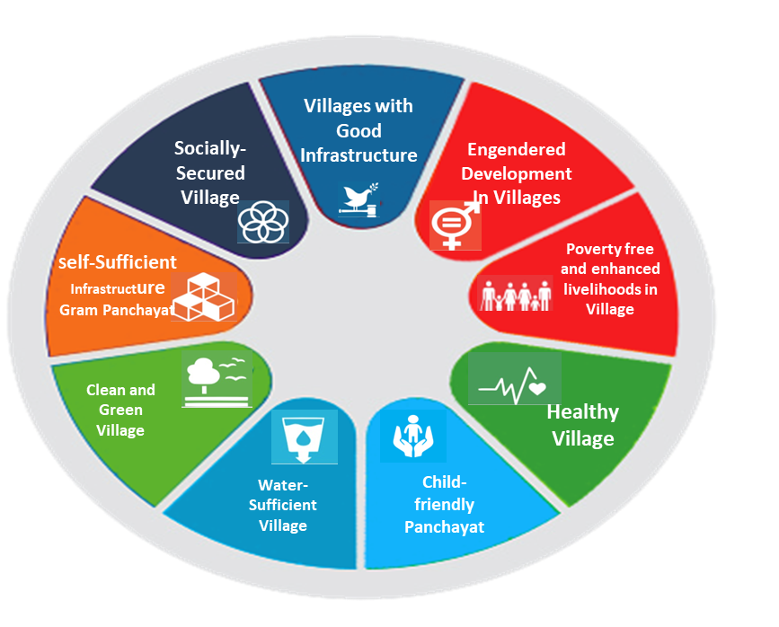
Themes
Theme 1: Poverty Free and Enhanced Livelihoods Village.
Theme 2: Healthy Village.
Theme 3: Child-Friendly Village.
Theme 4: Water Sufficient Village.
Theme 5: Clean and Green Village.
Theme 6: Village with Self-sufficient Infrastructure
Theme 7: Socially Just & Socially Secured Village
Theme 8: Village with Good Governance.
Theme 9: Women Friendly Village
  Each theme covers many SDGs, which in turn mapped to different ministries & schemes.
  Mapping result in convergence of resources and augment their availability at the Panchayat level

Slide 4

Stakeholders in LSDGs
Central Ministries / Departments
State Governments/UT Administrations
UN Agencies , Academic Institutions etc.
Panchayati Raj Institutions (PRIs)
(“Whole of Government and Whole of Society approach”)

Slide 5

Expectations & Initiatives
Expectations
> Inter-departmental convergence of Financial & Human Resource
> Environment creation, CB&T/ Orientation
> Better IEC & documentation of Best Practices
> Data Sharing, Repository of Data
> Preparation of Thematic Panchayat Development Plan with saturation approach
> List of activities for Master data
Initiatives
> Revamped Rashtriya Gram Swaraj Abhiyan (RGSA)for Capacity Building & Training
> Thematic workshops being conducted in States/ UTs on LSDGs.
> Thematic GPDP & revamping of portal (list of activities in drop down)
> Master GPDP (list of activities expected from States)
> Intensive CB&T/Orientation

Slide 6
Action points of 19-20 October, 2022
Action points | Timeline
As a first step of GPDP preparation Sankalp to be taken/ validated in GS and resolution uploaded on meeting online portal
Joint Advisory of line departments for ensuring greater participation of frontline workers in Gram Sabha. GoI has issued. | 15th November
Constitution Monitoring Committees for PPC-2022: State Level: District Level: Block Level: | By 5th November By 10th November By 15th November
Training /orientation of ERs, functionaries and other stakeholders as per following timeline: (i) State Level Master Trainers (ii) District Level Trainers (iii) Bock Level Trainers (iv) GPPFT | 27 Oct. to 5 Nov. 5 Nov. to 15 Nov. 10 Nov. to 20 Nov. 15 Nov.to 25 Nov.

Slide 7

Modification in eGram Swaraj
The basic purpose of thematic GPDP is to achieve saturation on all SDG goals by 2030. Following approach needs to be adopted:
Panchayats to allocate minimum 50% of untied (FFC/SFC/OSR) resources on the themes on which the panchayat has taken Sankalp as approved by Gram Sabha.
The remaining part of the FFC/SFC/OSR can be used on other felt need ofGP as approved by Gram Sabha.
These other activities need to be also recorded in respective themes, so that thematic progress of implementation of activities can be assessed from now onwards.
VPRP to be integrated in GPDP - Joint advisory issued by MoRD and MoPR.
VPRP activities mapped in different themes and included in drop down in the revamped portal

Slide 8
Modification in eGram Swaraj (Contd..)
GPDP is to be prepared with focus on themes of LSDGs, which is different from earlier GPDP (Sankalp to be focused)
Auto-population of theme-based list of activities
Automated mapping of focus areas with concerned activity
All flagship schemes, which are being implemented in a GP by other departments to be made part of revamped GPDP to make it comprehensive
Visualization of Panchayat wise beneficiary data while planning for a subsequent FY

Slide 9
Modification in eGram Swaraj (Contd..)
Requirement for Opening of Portal for uploading GPDP
Sankalp taken by all GPs
Uploading resolution of Gram Sabha on Sankalp
Updation of Gram Panchayat Profile (1454 GPs 11.61% of 12524 GPs)
Orientation by MoPR team in States/UTs and uploading feedback on portal.
Orientation at State/ District/ Block level PPC/GPDP team and information uploaded on portal on the pattern of IoP (SoP)

Slide 10
Preparation of Thematic GPDP
Intensive environment creation, orientation/ Capacity Building of ERs, Functionaries & other Stakeholders required
Meeting of Block level officials of all line departments
Availability /collection of required data
Placing draft plan before GS for approval
Approved plan to be uploaded the portal

Slide 11
MoPR Initatives
States/UTs are being continously orineted and handholding support is being provided on revamped portal for prepartion of thematic GPDP:
Workshop held 19-20 Oct. in Delhi.
VC meetings are being organised continously (held on 2nd Nov. & 11th Nov.)
State/UT wise mentors allocated for handholding supports.
PPC Booklet with step-wise procedure for prepartaion of Plan released.
Handbook of GPDP/eGramSwaraj portal with screenshots for easy understanding of revamped portal.
The above mentioed books and other resource material is available at website: https://www.panchayat.gov.in/web/ministry-of-panchayati-raj-2/people-s-plan-campaign-ppc-
Master GPDP on each theme prepared in a format of GPDP portal for guidance

Slide 12
THANK YOU

Slide 13
Sankalp
No. of GPs taken Sankalp: 12524 (100% of total GP of 12524 in Tamil Nadu)
Gram Sabha Resolution: 3952 (31.56% of total GP of 12524 in Tamil Nadu)
The status of Sankalp taken in all themes are as under:
Theme | No. of GPs taken Sankalp in different themes | % of GPs taken Sankalp in different themes
Theme 1: Poverty Free and Enhanced Livelihoods Village | 2376 | 18.97
Theme 2: Healthy Village | 5216 | 41.65
Theme 3: Child-Friendly Village | 4871 | 38.89
Theme 4: Water Sufficient Village | 6934 | 55.37
Theme 5: Clean and Green Village | 3707 | 29.60
Theme 6: Village with Self-Sufficient Infrastructure | 797 | 6.36
Theme 7: Socially Just and Socially Secured Village | 1896 | 15.14
Theme 8: Village with Good Governance | 1337 | 10.68
Theme 9: Women Friendly Village | 899 | 7.18
Back

Slide 14
Mapping of Themes, SDGs and Ministries
Theme No. | Theme | SDGs mapped | Nodal Ministry | Key Ministries/ Departments
1. | Poverty Free Village | 1,2,3, 4, 5, 6, 7, 8, 10, 11, 13 and 15 | Rural Development | Agriculture & Farmers welfare, Animal Husbandry, Fisheries, Skill Development
2. | Healthy Village | 2 and 3 | Health & Family welfare | AYUSH, Women & Child Development, Drinking Water and Sanitation
3. | Child-Friendly Village | 1,2,3,4 and 5 | Women & Child Development | School Education & Literacy, Health & Family welfare, Drinking Water and Sanitation

Slide 15
Mapping of Themes, SDGs and Ministries
Theme No. | Theme | SDGs mapped | Nodal Ministry | Key Ministries/ Departments
4. | Water Sufficient Village | 6 and 15 | Water Resources, River Development & Ganga Rejuvenation | Drinking Water and Sanitation, Agriculture & Farmers welfare, Land Resources
5. | Clean and Green Village | 6, 7, 12, 13, 14 and 15 | Drinking Water & Sanitation | Environment, Forest & Climate Change, New & Renewable Energy, Agriculture & Farmers welfare
6. | Village with Self-sufficient Infrastructure | 1,2,3,4,5,6,9 and 11 | Panchayati Raj | Rural Development, Electronics & Information Technology and Telecommunication

Slide 16
Mapping of Themes, SDGs and Ministries
Theme No. | Theme | SDGs mapped | Nodal Ministry | Key Ministries/ Departments
7. | Socially Secured Villages | 1,2,5,10 and 16 | Rural Development | Social Justice and Empowerment, Empowerment of Persons with Disabilities, Food & Public Distribution, Tribal Affairs
8. | Village with Good Governance | 16 | Panchayati Raj | Electronics & Information Technology, Telecommunication,
9. | Women Friendly Village | 1,2,3,4,5 and 8 | Women & Child Development | Health & Family welfare, Rural Development, Skill Development
Back

Slide 17
Monitoring Committees for PPC-2022 (State level)
Theme | Director/Joint Director/Deputy Director of concerned Departments
Poverty Free and Enhanced Livelihoods Village | Rural Development and Panchayat Raj
Healthy Village | Health & Family Welfare Department
Child-Friendly Village | School Education Department
Water Sufficient Village | Public Health Engineering /Drinking Water & Sanitation
Clean and Green Village | Public Health Engineering /Drinking Water & Sanitation
Village with Self- Sufficient Infrastructure | Rural Development and Panchayat Raj
Socially Just and Socially Secured Village | Social Welfare Department
Village with Good Governance | Panchayat Raj
Women Friendly Village | Women & Child Development

Slide 18
Monitoring Committees for PPC-2022 (District level)
Theme/Thematic Committee | Line Departments for concerned PDP | Chairperson | Members
Poverty free and enhanced livelihoods Village | D/o Rural Development & Panchayati Raj D/o Agriculture and Farmers Welfare | District Collector/ CEO Zilla Parishad | District level Officer handling NRLM, District level Officer handling MGNREGS District Panchayat Officer/ District Level Officer as Member Convenor
Healthy Village | D/o Health & Family Welfare D/o Ayush/ Ayurveda D/o Rural Development & Panchayati Raj D/o Women & Child Development | District Collector/CEO Zilla Parishad | Chief Medical Officer/District Health Officer/District Level Officer from D/o Women & Child Development Officer from D/o Ayush/Ayurveda Faculty (Health & Training Institute) District Panchayat Officer/ District Level Officer as Member Convenor
Child-Friendly Village | D/o Health & Family Welfare D/o School Education D/o Rural Development & Panchayati Raj | District Collector/CEO Zilla Parishad | Deputy Director/District Level Officer (D/o Elementary Education) District Level Officer dealing with Reproductive and Child Health District Panchayat Officer/District Level Officer as Member Convenor

Slide 19
Monitoring Committees for PPC-2022 (District level)
Theme/Thematic Committee | Line Departments for concerned PDP | Chairperson | Members
Water Sufficient Village | D/o Public Health Engineering /Drinking Water & Sanitation D/o Rural Development & Panchayati Raj | District Collector/CEO Zilla Parishad | District Level Officer nominated from Public Health Engineering /Drinking Water & Sanitation District Level Officer nominated from Rural Development Department District Panchayat Officer/District Level Officer as Member Convenor
Clean and Green Village | Public Health Engineering /Drinking Water & Sanitation D/o New and Renewable Energy D/o Rural Development & Panchayati Raj | District Collector/CEO Zilla Parishad | District Level Officer nominated fromPublic Health Engineering /Drinking Water & SanitationDistrict Level Officer dealing with renewable energyDistrict Level Officer from Rural Development Department dealing with SBM-GDistrict Panchayat Officer/ District Level Officer as Member Convenor
Village with Self- Sufficient Infrastructure | D/o Rural Development & Panchayati Raj D/o Electronics & Information Technology/NIC D/o Telecommunications | District Collector/ CEO Zilla Parishad | District Level Officer from NICDistrict Level Officer dealing with BharatNETDistrict Panchayat Officer/District Level Officer as Member Convenor

Slide 20
Monitoring Committees for PPC-2022 (District level)
Theme/Thematic Committee | Line Departments for concerned PDP | Chairperson | Members
Socially Just and Socially Secured Village | D/o Social Welfare D/o Rural Development & Panchayati Raj | District Collector/CEO Zilla Parishad | District Level Officer from Rural Development Department dealing with National Social Assistance Programme (NSAP) District Level Officer from D/o Social Welfare District Panchayat Officer/ District Level Officer as Member Convenor
Village with Good Governance | D/o Rural Development & Panchayati Raj D/o Electronics & Information Technology/NIC | District Collector/CEO ZillaParishad | District Level Officer from Panchayati Raj dealing with e-GramSwaraj District level officer from NIC District Panchayat Officer/District Level Officer as Member Convenor
Women Friendly Village | D/o Health & Family Welfare D/o School Education & Literacy D/o Ayush/Ayurveda D/o Rural Development & Panchayati Raj | District Collector/CEO Zilla Parishad | Chief Medical Officer District level Officer from D/o Rural Development Department District level Officer from D/o Ayush/Ayurveda District level Officer from D/o Elementary Education District Level officer dealing with SRLM District Panchayat Officer/District Level Officer as Member Convenor

Slide 21
Monitoring Committees for PPC-2022 (Block level)
Theme/Thematic Committee | Line Departments for concerned BPDP/ GPDP | Chairperson | Members
Poverty free and enhanced livelihoods Village | D/o Rural Development & Panchayati Raj D/o Agriculture and Farmers Welfare | Block Development Officer | Block Level Officer handling SRLM Officer handling MGNREGS Panchayat Level Extension Officer/ Equivalent Officer as Member Convenor
Healthy Village | D/oHealth & Family Welfare D/o Ayush/ Ayurveda D/o Rural Development & Panchayati Raj D/o Women & Child Development | Block Development Officer | Block Medical Officer Child Development Programme Officer (CDPO) Panchayat Extension Officer/ Officer holding Equivalent position in Block as Member Convenor
Child-Friendly Village | D/o Health & Family Welfare D/o School Education D/o Rural Development & Panchayati Raj | Block Development Officer | CDPO Panchayat Extension Officer/ Officer holding Equivalent position in Block as Member Convenor

Slide 22
Monitoring Committees for PPC-2022 (Block level)
Theme/Thematic Committee | Line Departments for concerned BPDP/ GPDP | Chairperson | Members
Water Sufficient Village | D/o Public Health Engineering /Drinking Water & Sanitation D/o Rural Development D/o Rural Development & Panchayati Raj | Block Development Officer | Block level officer/Junior Engineer/ Assistant Engineer Panchayat Extension Officer/ Officer holding Equivalent position in Block as Member Convenor
Clean and Green Village | Public Health Engineering /Drinking Water & SanitationD/o New and Renewable EnergyD/o Rural Development & Panchayati Raj | Block Development Officer | Officer from Block handling SBM-G Panchayat Extension Officer/ Officer holding Equivalent position in Block as Member Convenor
Village with Self- Sufficient Infrastructure | D/o Rural Development & Panchayati Raj D/o Electronics & Information Technology/NIC D/o Telecommunications | Block Development Officer | Block level officer/Junior Engineer/ Assistant Engineer Panchayat Extension Officer/ Officer holding Equivalent position in Block as Member Convenor

Slide 23
Monitoring Committees for PPC-2022 (Block level)
Theme/Thematic Committee | Line Departments for concerned BPDP/ GPDP | Chairperson | Members
Socially Just and Socially Secured Village | D/o Social Welfare D/o Rural Development & Panchayati Raj | Block Development Officer | Social Welfare Officer at Block Level Panchayat Extension Officer/ Officer holding Equivalent position in Block as Member Convenor
Village with Good Governance | D/o Rural Development & Panchayati Raj D/o Electronics & Information Technology/NIC | Block Development Officer | Nominated member from NIC Block Level Officer from BBNL Panchayat Level Extension Officer/ Officer holding Equivalent position in Block as Member Convenor
Women Friendly Village | D/o Health & Family Welfare D/o School Education & Literacy D/o Ayush/ Ayurveda D/o Rural Development & Panchayati Raj | Block Development Officer | CDPO Block Education Officer/ Equivalent Block Medical Officer Panchayat Level Extension Officer/ Officer holding Equivalent position in Block as Member Convenor
Back

Slide 24
Main goals of other themes
Theme:1
Poverty Free village
Comprehensive coverage of all eligible beneficiaries under livelihood and social protection schemes including PDS, ICDS etc.
Economic Development & employment generation through individual / collective enterprise
Theme 2:
Healthy Village
Eliminate stunting and wasting in 0-6 yrs. of child.
Eliminate anaemia amongst adolescent girls & women.
Zero maternal deaths, child deaths under 5 years.
Provision for medical care and health facilities for all.
Theme: 3
Child Friendly village
100% enrolment in the school.
Reduce Drop-out ratio
Quality Education
100% Immunisation of children
100% child labour free.
No Trafficking cases
Ensure protected environment from all kinds of violence against children.

Slide 25
Main goals of other themes
Theme:4
Water Sufficient Village
Access to potable water facilities to every household.
Grey water treatment & purification.
Address groundwater depletion, arsenic contamination, rainwater harvesting & groundwater recharge.
Theme: 5
Clean and Green Village
100% ODF villages
Solid & Liquid Waste management
Shift from non-renewable to renewable source of energy.
Enhanced green cover through social forestry use of local nursery.
Ensuring conservation of biodiversity and sustainability of ecosystems
Theme: 6
Self-Sufficient Infrastructure
Ensure establishment of quality infrastructure - GP Bhawan, AWC, Schools, Health Centre, CSC, separate toilets with running tap water provision in schools.
Ensure all weather connectivity roads, solar street lights and community solar tree, ensure pucca house for all.

Slide 26
Main goals of other themes
Theme 7:
Socially Secured Village
Improving living standards of the BPL households
Ensure social protection through pensions to all eligible
Appropriate infrastructure and facilities for person with disability (Disabled-friendly).
Theme 8:
Village with Good Governance
Coordination and convergence among various institutions/ stakeholders for preparation of GPDP
Involvement of SHG/ village committees in localization of SDGs
Promoting better public service delivery by use of technology.
Theme 9:
Women Friendly Village
100% immunisation of pregnant women
Reduce crimes against women and girls.
Improve participation of women in socio-political, economic activities and participation in community-based organisations.
Equal wages for equal pay to the women.

